Slide 1

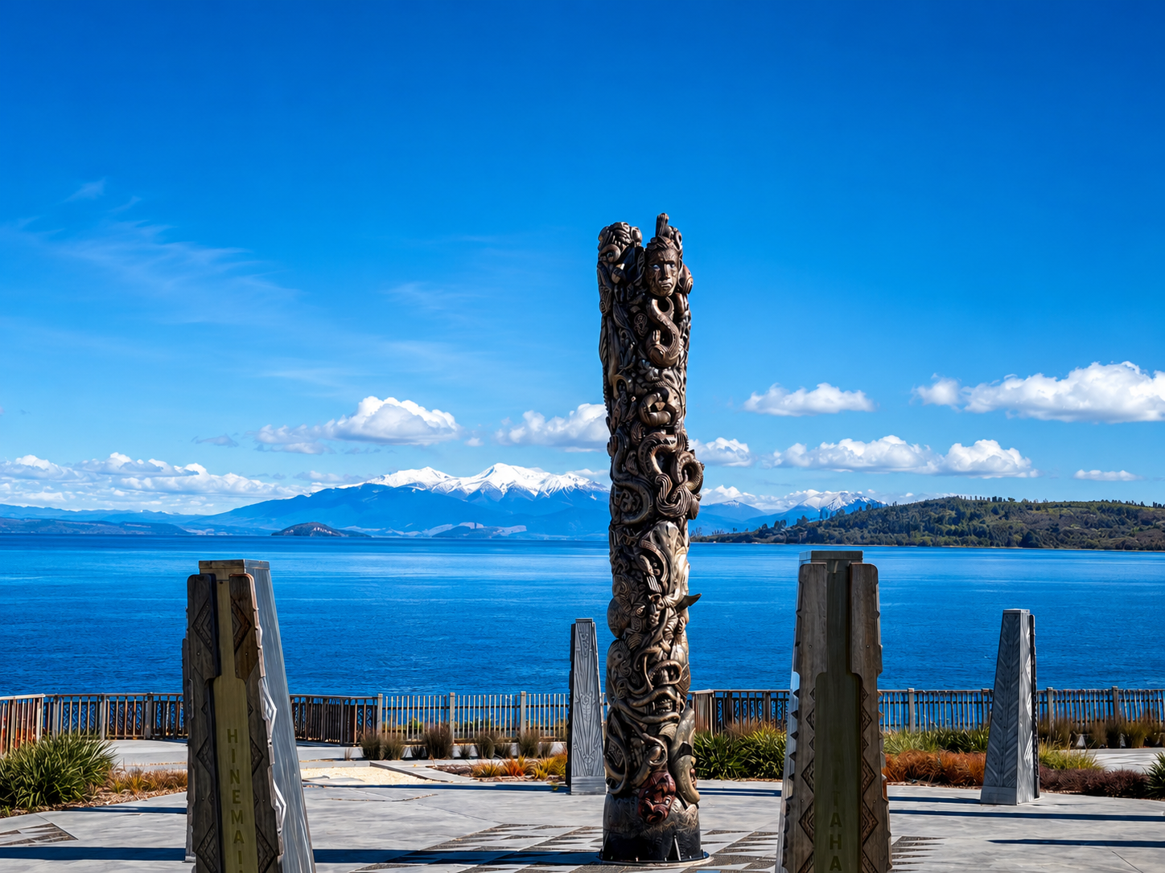
Welcome
Nau mai haere mai
Taupō Hospital & Health Society
Supporting the Taupō–Tūrangi & Mangakino region by strengthening and supporting our local hospital and the health services it provides to our community.
Click here
Get in Touch

Slide 2
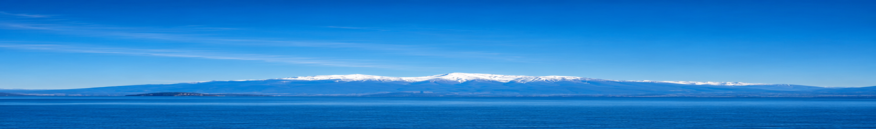
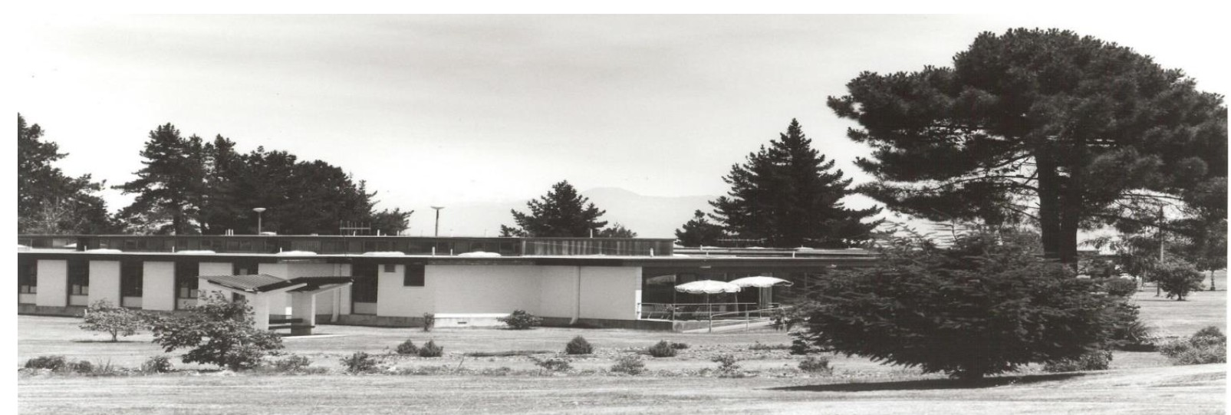
Background/Horopaki
OUR HISTORY
Taupō Hospital & Health Society
A community-led commitment to protecting and strengthening local health services since 1992
Community beginnings
The Taupō Hospital & Health Society grew from a major community meeting held more than 30 years ago, when rumours emerged that Taupō Hospital might close. More than 1,000 businesspeople, councillors, health professionals and community members attended. Together, they agreed to establish an independent society that would work alongside the hospital, raise funds for essential equipment and help safeguard local health services.
The Society was formally incorporated in 1992 and has been governed by a voluntary Board ever since.
Community leadership
The Society’s leadership has included prominent local businesspeople, councillors and health professionals. Early and long-serving contributors included the late Mayor Joan Williamson, Joan Gartner, Bruce Hodgkinson, Eileen Clapperton. Laurie Burdett, Joan Gartner, and Les Winslade have also supported the Society as patrons. Their collective service helped establish the Society as a trusted and enduring Taupō community organisation.

Slide 3
Background/Horopaki
OUR HISTORY…
Fundraising and community support
Funding has been generated through membership subscriptions, corporate contributions, Life in Perpetuity memberships, community fundraising, philanthropic gifts and generous bequests. A notable campaign raised more than $100,000 for the Pihanga Health Centre.
While Taupō Hospital remains the Society’s primary focus, support has also been provided to organisations contributing to local health and wellbeing, including Taupō Hospice, Anamata, Taupō Bowling Club and other eligible community agencies.
Our district and ongoing partnership
The Society serves the wider Taupō District, including Taupō, Tūrangi and Mangakino. It maintains a strong relationship with Taupō Hospital and Health New Zealand. For over 30 years, the Society has worked closely with the hospital and Lakes health service management, supported by a formal Memorandum of Understanding.
Today, the Society continues the vision of its founders by bringing the community together to improve healthcare services, facilities and wellbeing throughout the district.

Slide 4
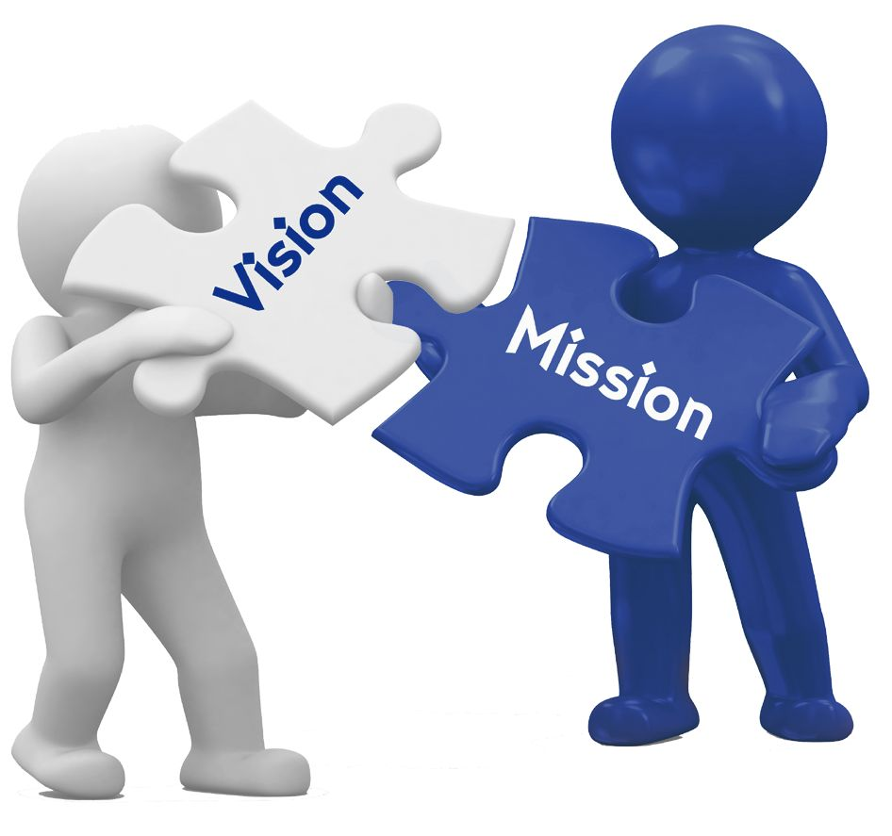
Our Vision/ Tō mātou tirohanga
MISSION/VISION
“ The Society is committed to supporting and improving health and hospital services in the Taupo region. We strive to create a healthier, more vibrant community through dedicated support and strategic initiatives."

Slide 5

What we do?/ Ā mātou mahi
PURPOSE
The Taupō Hospital & Health Society is established and operated exclusively for charitable purposes. Our objectives are to:
Support the continuation and development of healthcare services for people throughout the Taupō region.
Promote initiatives that support people in need of physical, mental or spiritual healthcare, regardless of race, culture, beliefs or religious affiliation.
Use the Society’s funds to support and assist Taupō Hospital through financial contributions, gifts, loans or other forms of assistance considered appropriate by the Committee.
Support the advancement, education, promotion or benefit of other organisations whose work aligns with the Society’s charitable aims and purposes.
Work collaboratively with incorporated and unincorporated organisations that share aims and purposes similar to those of the Society.

Slide 6
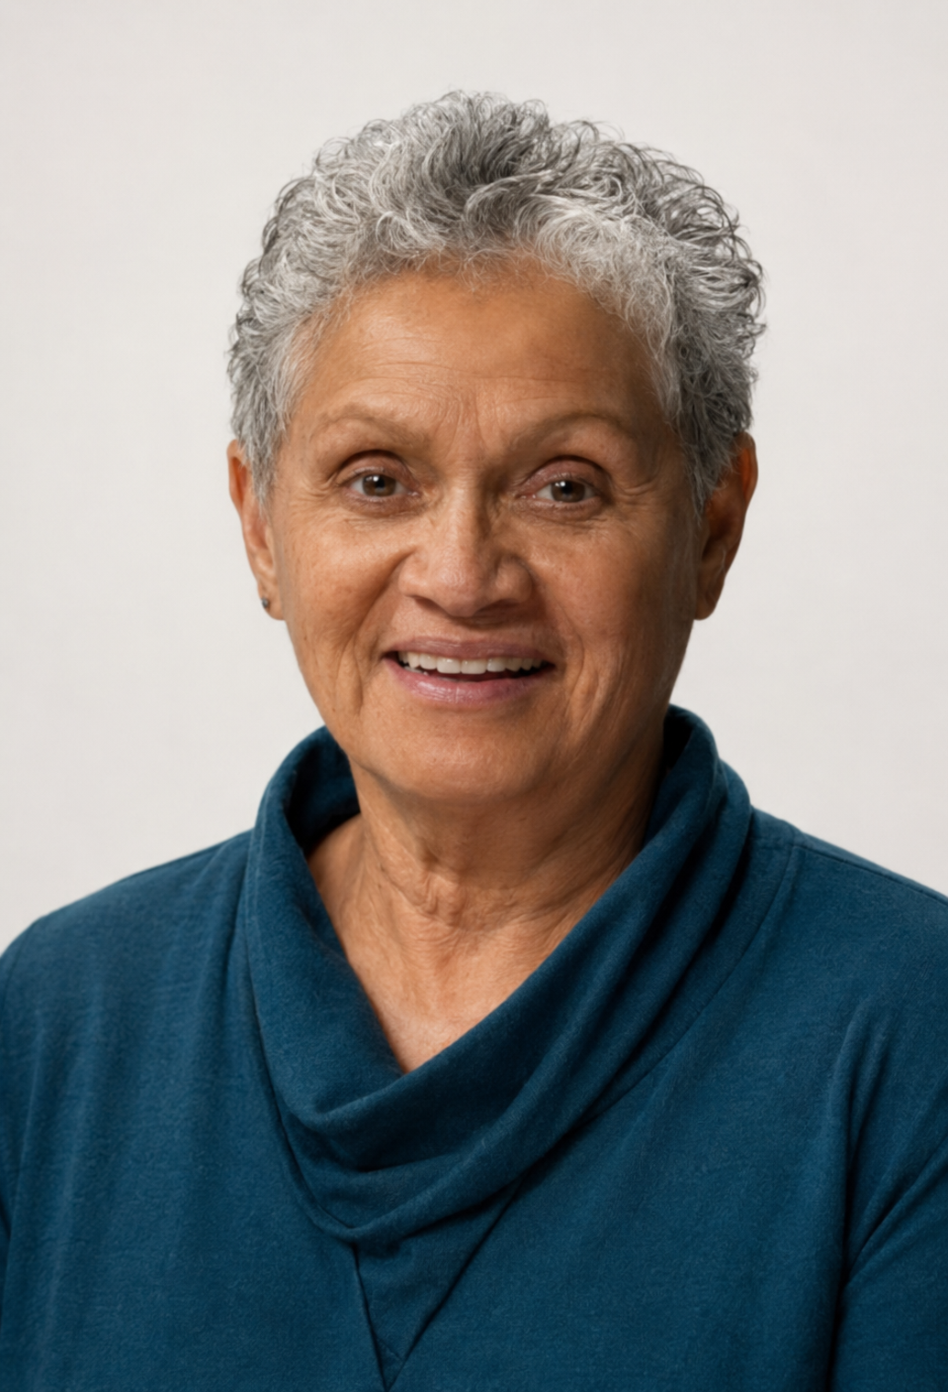
Our Board – Mana whakahaere
Lil Hancock
CHAIR
Key Skills: – Strategic Leadership, Financial & Accounting, Health & Community, Fundraising, Board & Committee Governance, Stakeholder Engagement, Community Advocacy, Strategic Planning & Oversight, Accountability & Decision-Making, Community Wellbeing & Equity
Lil has been a committee member of the Society since 2011 and Chairperson since 2017, bringing more than 45 years of leadership and governance experience across the not-for-profit, health, and community sectors. Under her leadership, the Society successfully raised $350,000 for an echocardiogram machine for Taupo Hospital, strengthening cardiac services for the local community.
With qualifications in Business Management and Accounting, Lil brings strong financial and strategic expertise and a deep commitment to community wellbeing. She has held leadership roles with COGS and received the Lake Taupō District Sports Awards Supreme Award for her outstanding service to the community. Her dedication to equitable access to health and community services continues to shape the Society’s vision and impact across the region.

Slide 7
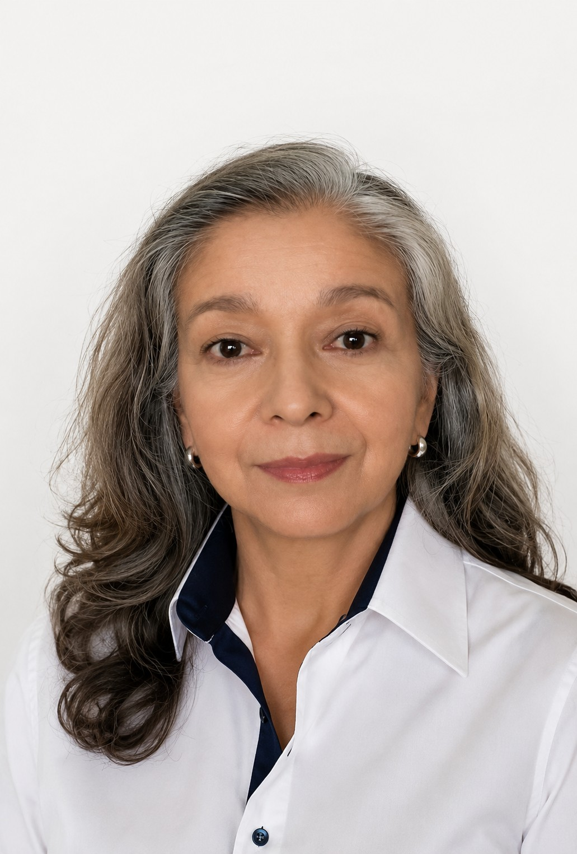
Our Board – Mana whakahaere
GILMA OROZCO
DEPUTY CHAIR
Key Skills:– Strategic thinking, research and analytical skills, Organisational development, collaborative leadership. Strong understanding of community wellbeing, empowerment and not-for-profit sustainability,
Gilma has been a valued member since 2011, commencing her involvement as Administrator and playing a key role in supporting the Society’s ongoing impact within the Taupō community. With qualifications in social research psychology and more than 18 years’ experience across the public and private sectors in NZ and internationally, she brings extensive expertise in research, community engagement, and organisational development. Passionate about empowering communities and strengthening wellbeing outcomes, Gilma contributes strategic insight and a strong commitment to the growth and sustainability of not-for-profit initiatives.

Slide 8
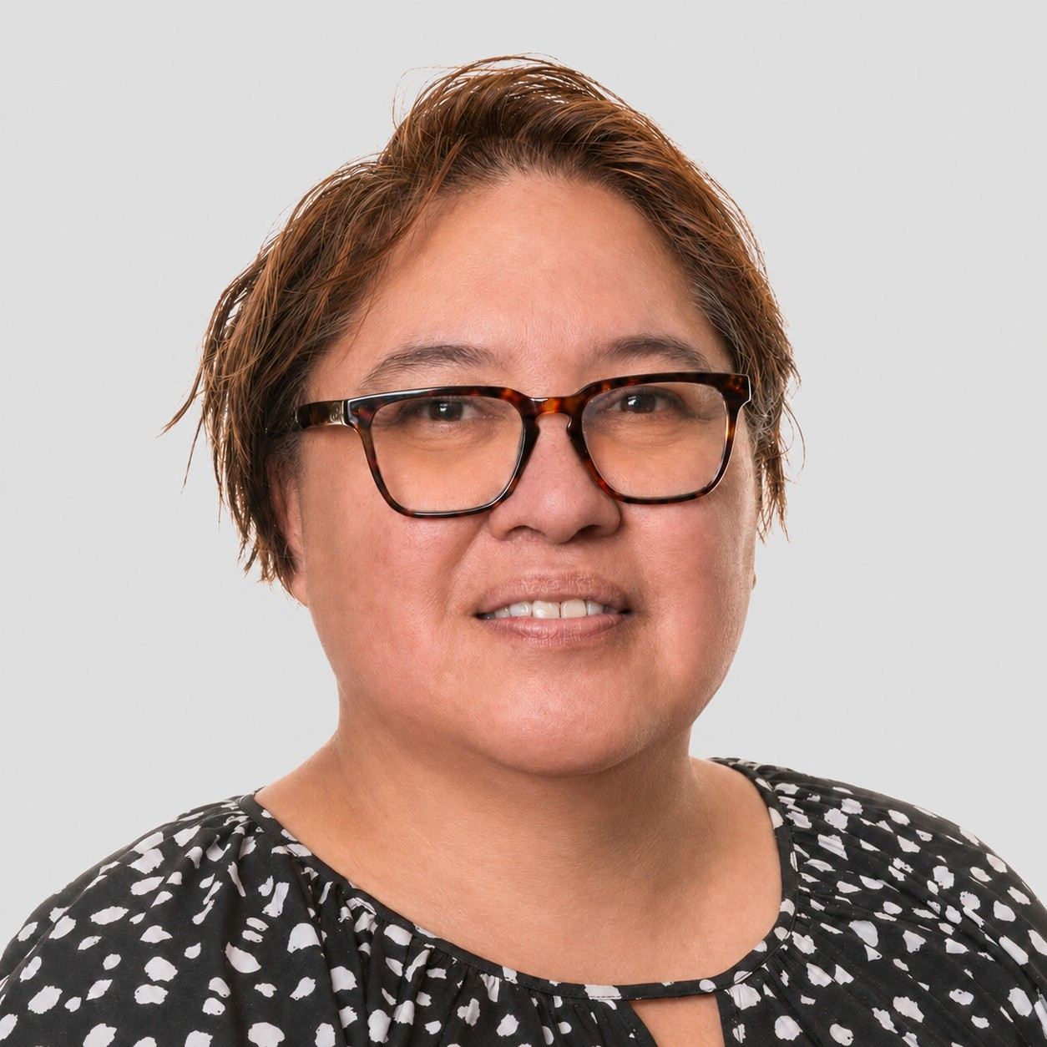
Our Board – Mana whakahaere
DEBBIE DAVIES
BOARD MEMBER
Key Skills: Strategic Leadership, Financial Governance & Oversight, Audit & Risk Management, Compliance & Accountability, Iwi & Community, Collaborative Leadership.
Deb is an experienced governance, finance, and administration professional with more than 20 years of experience across iwi, not-for-profit, commercial, and public-sector organisations. She brings a strategic, values-driven approach, grounded in strong relationships with iwi, hapū, and community, alongside deep expertise in financial management, compliance, and stakeholder engagement.
Deb holds multiple governance roles within Raukawa Group, including Audit & Risk Chair and Deputy Chair of the Raukawa Charitable Trust. She is recognised for her collaborative leadership, clear communication, and ability to bridge governance and operational delivery. Her experience enables her to provide sound strategic oversight while maintaining a strong focus on accountability, risk, and sustainable outcomes.

Slide 9
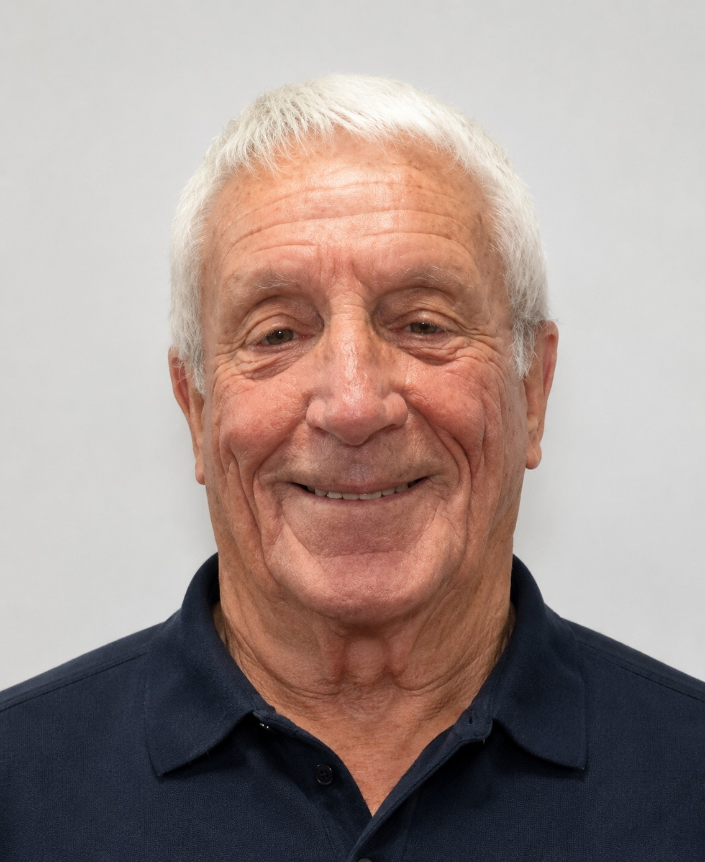
Our Projects
Ā mātou kaupapa
Our Board – Mana whakahaere
TRENT HANCOCK
BOARD MEMBER
Key Skills: Financial administration and management, financial stewardship, governance, budgeting and reporting, treasury management, organisational administration, compliance, risk awareness, extensive community organisation experience.
Trent is a retired office manager with extensive experience in financial administration and governance. He has served as Treasurer of the Lake Taupō Sports Advisory Council and the Lake Taupō Sports Foundation for more than 25 years, and as Treasurer of the Society for five years. He has also been Treasurer of the golf section of the Taupō Cosmopolitan Club. Trent brings proven financial stewardship, reliability, and a strong commitment to supporting community organisations.

Slide 10
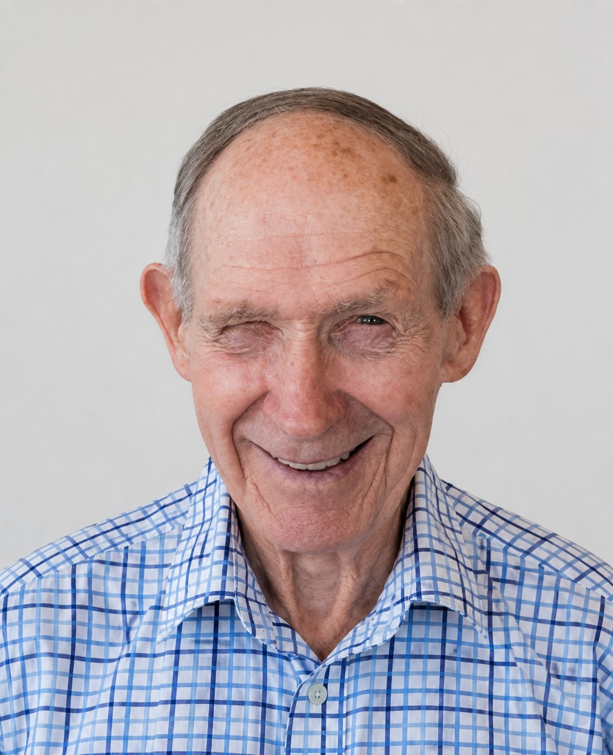
Our Projects
Ā mātou kaupapa
Your Board – Mana whakahaere
Mark O’Callaghan
BOARD MEMBER
Key Skills: Community leadership, volunteer management, sports administration, governance, relationship building, community engagement, strategic leadership, organisational support, fundraising, and a strong commitment to serving the Taupō community.
Mark has been a valued part of the Taupō community since 1976, bringing a lifelong commitment to service, leadership, and local sport. With deep roots in farming and decades of involvement in rugby administration and volunteering, he was recognised with the New Zealand Order of Merit in 2003 for his contributions to the sport. Mark continues to support the community through his roles with Red Cross Taupō, the Lake Taupo Sports Advisory Council, and our society, where his experience and dedication continue to make a lasting impact.

Slide 11
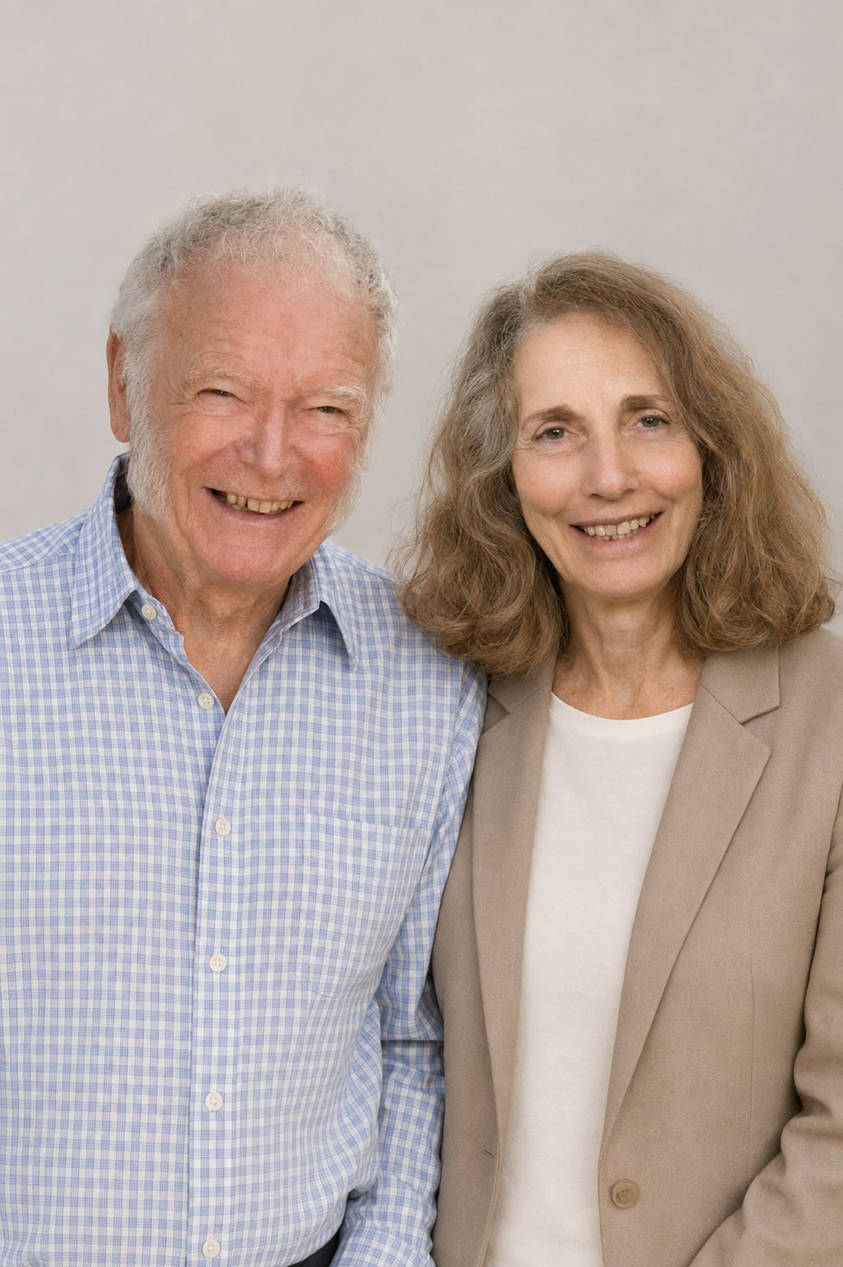
Your Board – Mana whakahaere
David & Sandra Foss
BOARD MEMBERS
Key Skills: Community leadership, healthcare and wellbeing, nursing and clinical experience, volunteer coordination, community engagement, local knowledge, practical problem-solving.
David and Sandra are long-standing Taupō locals whose lives and careers have been closely connected to the wellbeing of their community. Together, they bring more than five decades of service, leadership, and volunteer experience, along with deep local knowledge, practical insight, and a shared commitment to supporting quality, equitable health services in Taupō.
David’s background spans the boating and trucking supply industries, alongside years of community involvement through scouting, boating, and volunteer work. Sandra is a retired registered nurse with extensive experience at Taupō Hospital. She has dedicated her career to healthcare and community wellbeing, including more than 20 years supporting Ironman medical services.
Together, they remain active contributors to the community and are united by a shared vision of a healthy, connected, and thriving Taupō.

Slide 12
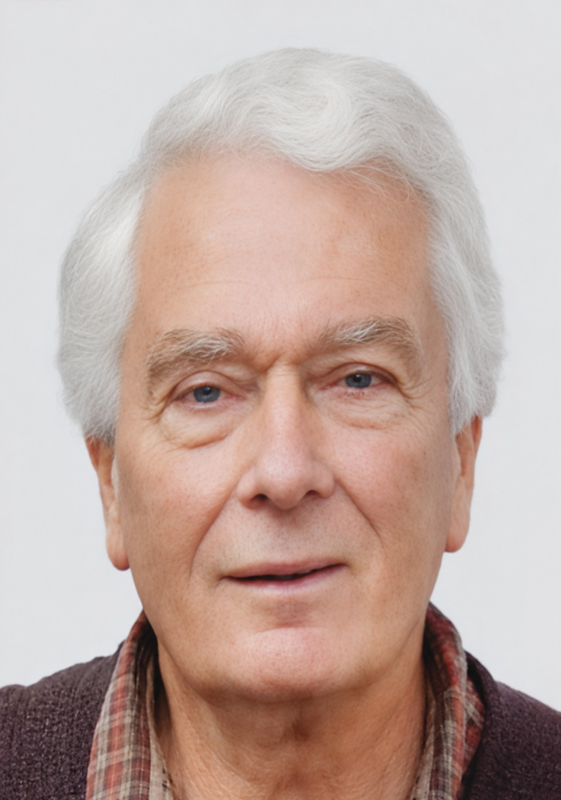
Our Projects
Ā mātou kaupapa
Your Board – Mana whakahaere
John Williamson
BOARD MEMBER
Key Skills: Community leadership, governance, public service, strategic decision-making, stakeholder engagement, advocacy, policy development, organisational leadership, community development, arts and cultural sector knowledge, environmental awareness, infrastructure oversight, education and health sector engagement, extensive knowledge of the Taupō community.
A proud Taupō local for more than 60 years, John has built a lifelong legacy of community leadership, governance, and public service. With more than 20 years of involvement in the Rotary Club of Taupō and with experience across community, health, arts, and education organisations, he has contributed to a wide range of initiatives that strengthen the Taupō district. He currently serves as President of Grey Power Taupō and has held governance roles with the Taupō School of Music, Life Education Trust Central Plateau, and our Society. From 2013 to 2025, he served four terms as a Taupō District Councillor, providing leadership across the arts, environmental, infrastructure, and community portfolios. His commitment to community wellbeing also extends to organisations including the Lake Taupō Cycle Challenge, Friends of the Museum and Art Gallery, and the Waipahihi Botanical Society.

Slide 13
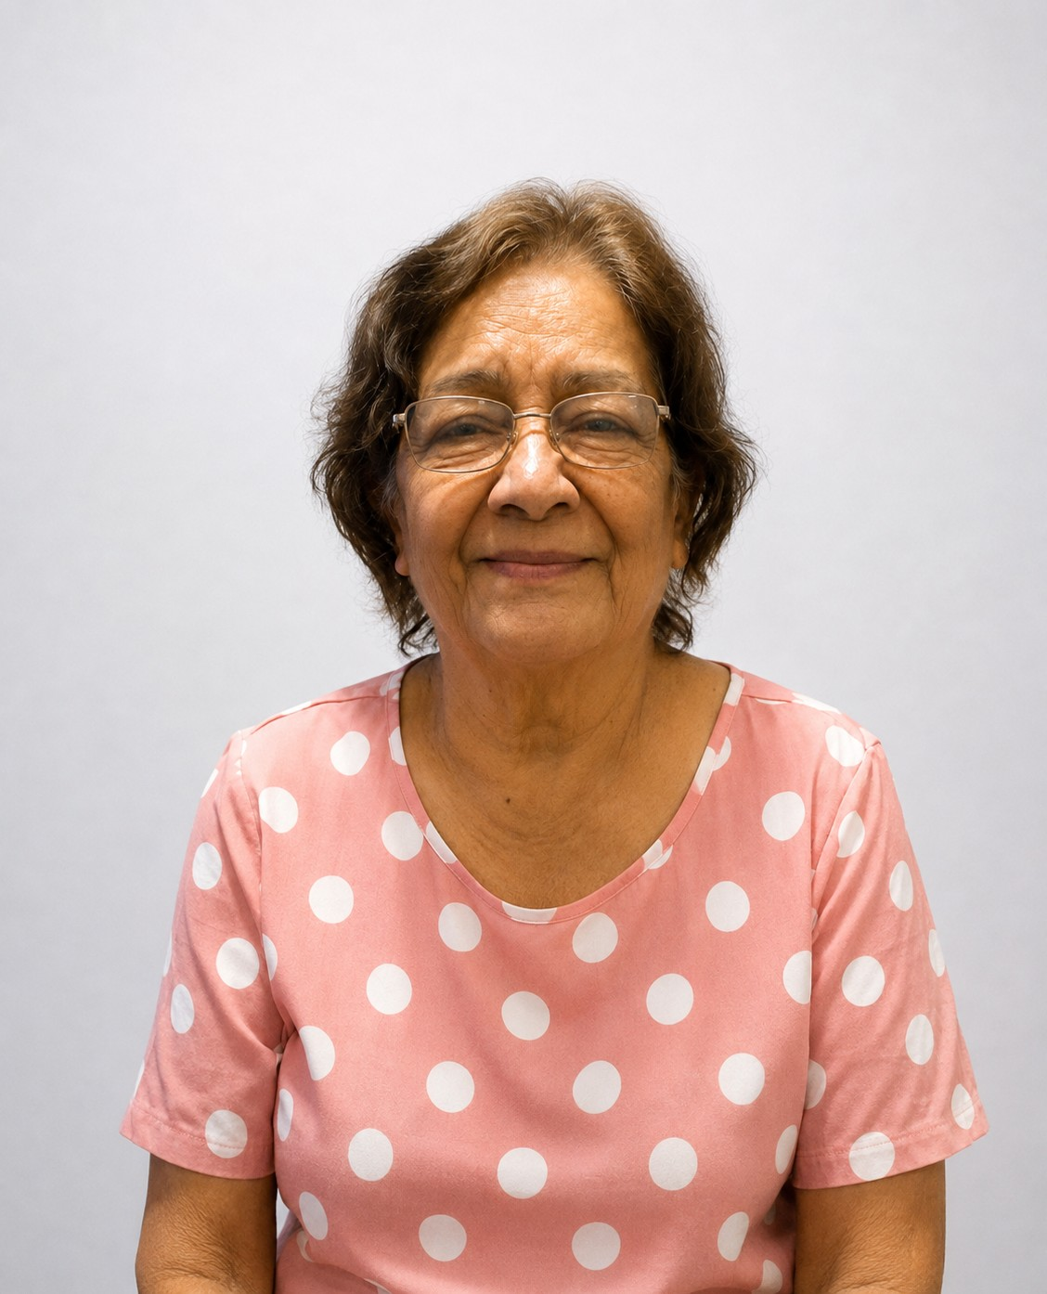
Our Projects
Ā mātou kaupapa
Your Board – Mana whakahaere
Aruna Singh
BOARD MEMBER
Key Skills: Community leadership, volunteer coordination, fundraising, event management, relationship building, community engagement, cross-cultural communication, partnership development, advocacy, teamwork, and a strong commitment to supporting diverse and connected communities.
Aruna has been a valued member of the Society for several years and a respected community leader with more than 30 years of volunteer service in Taupō. As Chair and President of the Kiwanis Club of Taupō, she helps mobilise volunteers, support major local events, and lead fundraising initiatives that make a meaningful impact locally and internationally. Proud of her Tongan and Fijian Indian heritage, Aruna brings a people-first approach and a passion for building connections across cultures and communities.

Slide 14
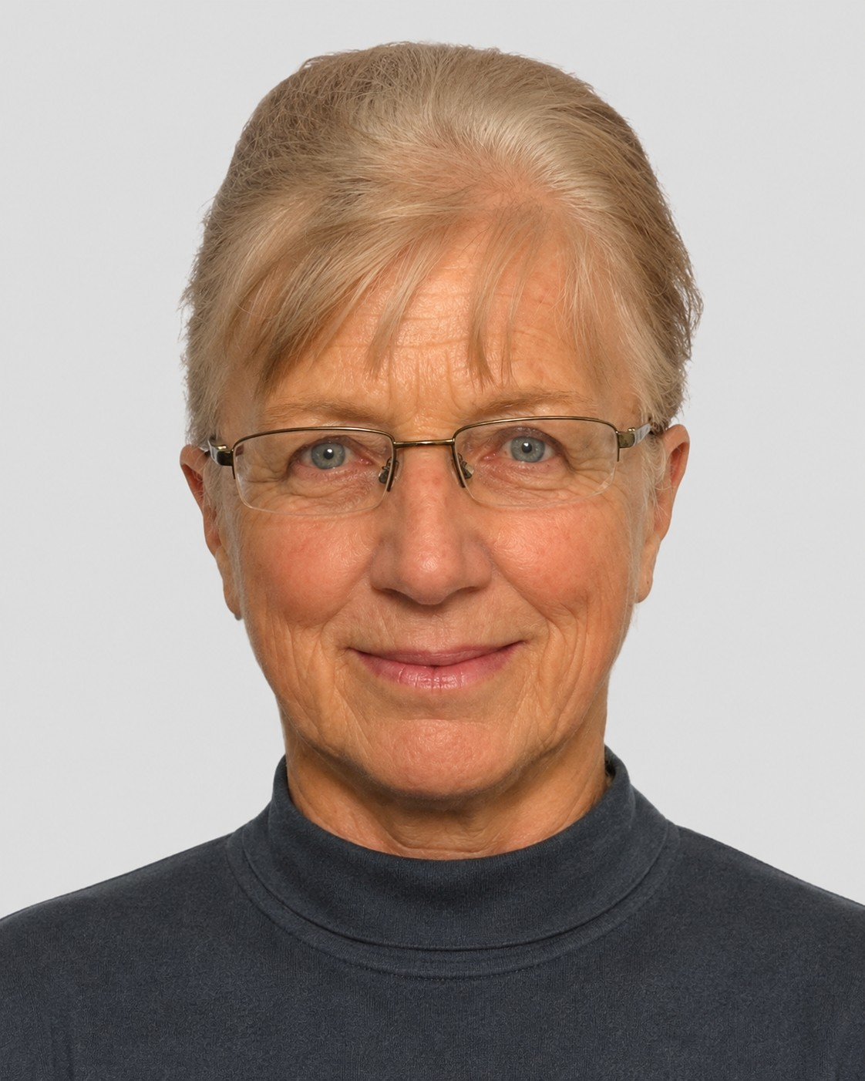
Our Patron – Kaitautoko
LAURIE BURDETT
PATRON
Key Skills: Health Governance, Strategic Leadership, Public Sector Governance, Community Leadership, Risk & Decision-Making, Regional Governance, Stakeholder Engagement, Conservation Governance.
Laurie has served as Patroness of the Society since 2017, bringing decades of leadership across healthcare, governance, conservation, and community service. A registered nurse and midwife, she held senior clinical and management roles at Taupō Hospital for 23 years, including Charge Nurse, Principal Nurse, and Manager, before moving into regional health leadership with the Regional Health Funding Authority.
Her extensive governance experience includes elected service on both the Hospital Board and Waikato Regional Council, along with appointments to the Tongariro Taupō Conservation Board and Regional Lottery Welfare Committee. Lauri also served with distinction in the Territorial Army, retiring with the rank of Major after overseas deployments in Tonga and the Solomon Islands.

Slide 15
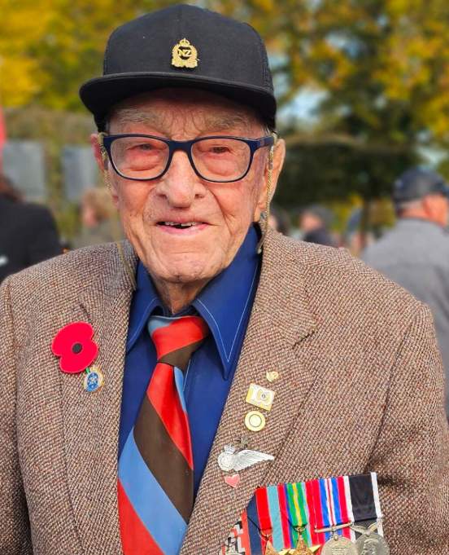
RETIRED Patron – Kaitautoko
LES WINSLADE
RETIRED PATRON
Leslie ‘Les’ Winslade QSM celebrated his 105th birthday surrounded by family, friends and memories of a remarkable life of service.
Born in England, Les migrated to New Zealand in 1926. He served as an RNZAF wireless operator during the Second World War, including time in Guadalcanal, before building a long career with National Mutual.
Community service has been central to Les’ life. After moving to Taupō in 1983, he became involved with Lions, established the local Neighbourhood Watch and raised more than $2 million for health and medical improvements across the Taupō and Tūrangi districts. He also strongly advocated for geothermal heating at Taupō Hospital.
Les received the Queen’s Service Medal in 2009 and has been recognised with both Rotary International’s Paul Harris Award and Lions International’s Melvin Jones Fellowship—a rare achievement. Believed to be the region’s oldest surviving veteran, Les remains an inspiring example of service, generosity and commitment to his community

Slide 16
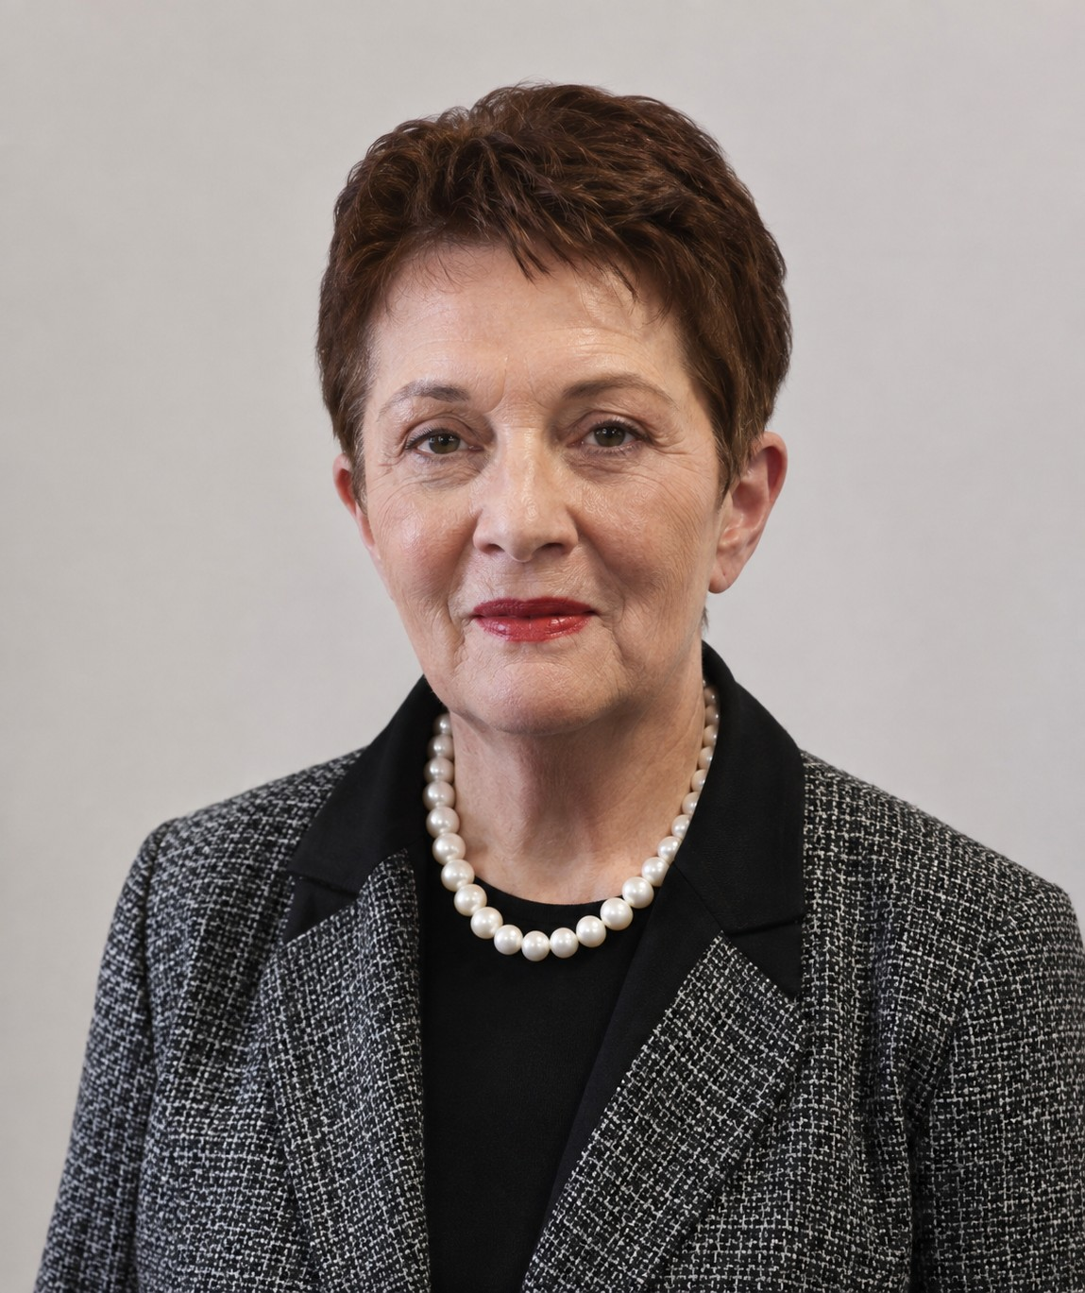
Our Projects
Ā mātou kaupapa
Associate member– Mema hono
KATHRYN UVHAGEN
ASSOCIATE MEMBER
Key Skills:– strong skills in governance, strategic leadership, public-sector management, community engagement, environmental stewardship, and local-government decision-making. Her experience also demonstrates strengths in relationship building, teamwork, communication, event facilitation, resource recovery initiatives, arts advocacy, and supporting positive outcomes for the Taupō community.
Kathryn is a respected Taupō community leader with extensive experience in local government, public service, and community development. A former Taupō District Councillor, she served the district for multiple terms and contributed to environmental, resource recovery, arts, and community initiatives. Kathryn has also served on the Tongariro/Taupō Conservation Board and supported local arts organisations, memorial scholarships, and community events. In her professional role as a Team Leader with Stats NZ, she brings strong leadership, organisational expertise, and a commitment to serving people and communities.

Slide 17
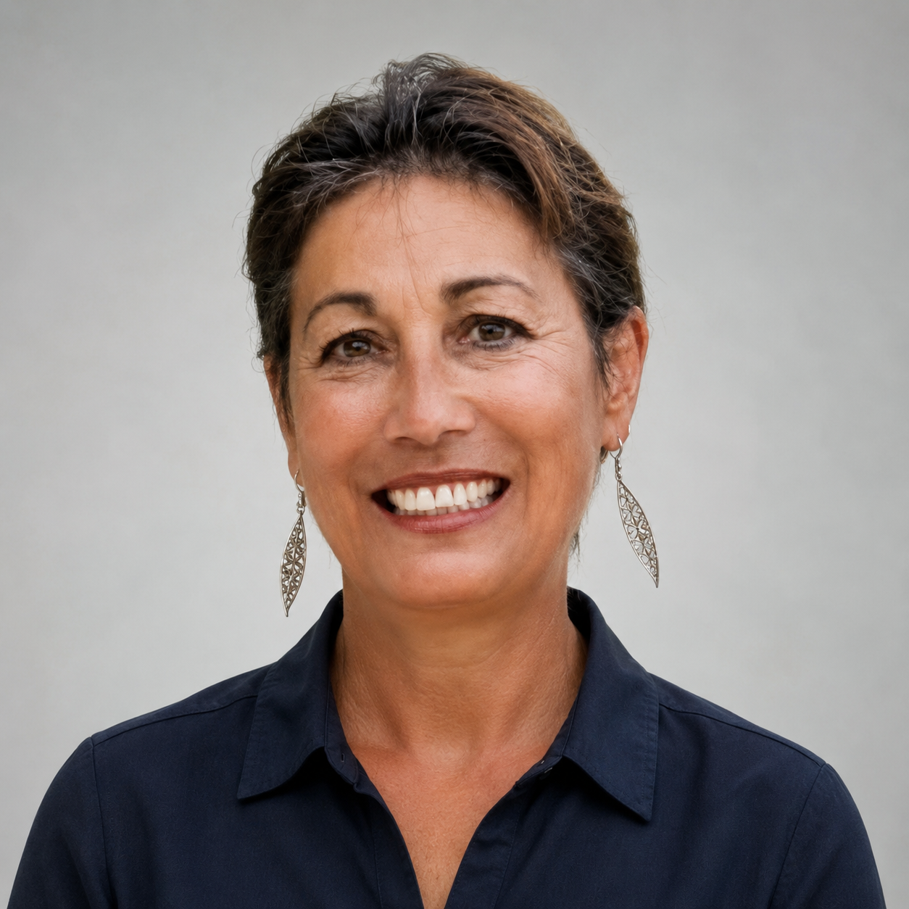
Associate member– Mema hono
Rhonda Tawhai
ASSOCIATE MEMBER
Key Skills:– Administration, Board Support, Minute-Taking, Community Service, Mirimiri. Waka Ama.
After many years of travelling, Rhonda has returned home, bringing with her a wealth of knowledge, experience and practical skills. A true jack of all trades, she has experience in administration, minute-taking, board coordination, massage and mirimiri.
Rhonda has generously volunteered her time and skills to numerous organisations, assisting with administration, organising board activities and providing reliable support wherever it is needed.
Her greatest passion is waka ama. Rhonda has contributed to Waka Ama New Zealand for many years, undertaking a variety of roles and competing as a paddler. Her versatility, dedication and strong commitment to her community make her a valued addition to any organisation fortunate enough to have her support.

Slide 18


Rules– Ngā ture
INCORPORATED SOCIETY
Ash to link the rules to click on and link to constitution – not a download

Slide 19
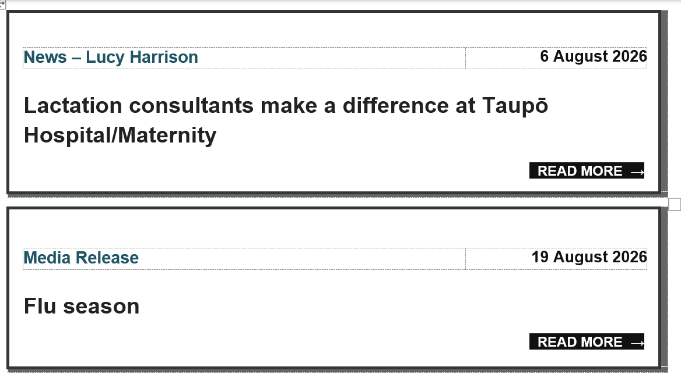
Our Projects
Ā mātou kaupapa
News/Nga Kārere
LATEST NEWS

Slide 20
Our Projects
Ā mātou kaupapa
News/Nga Kārere
ARCHIVE NEWS

Slide 21









Our Projects
Ā mātou kaupapa
News/Nga Kārere
ANNUAL REPORTS

Slide 22


Our Projects
Ā mātou kaupapa
News/Nga Kārere
Social Media
Link our facebook page
Link

Slide 23
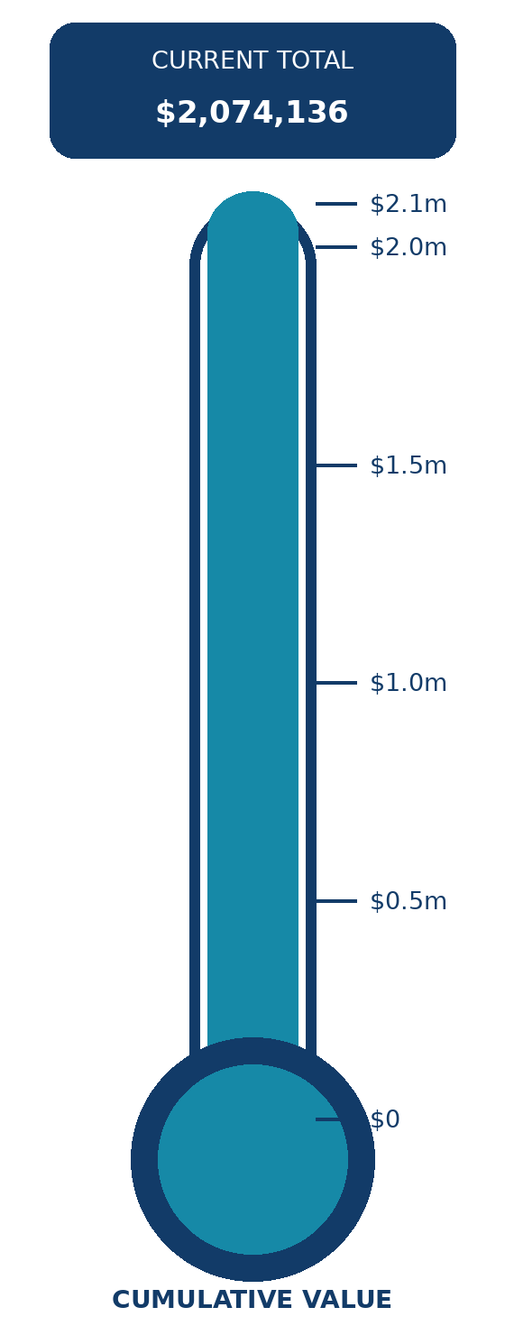
SUCCESSES
Selected grants and purchases supported since 1993 | Latest recorded cumulative value: $2,074,136
YEAR
TOTAL
EXAMPLES OF GRANTS AND PURCHASES
2024
$2,074,136
Anamata Cafe: clinic bed, blood-pressure monitors and otoscope; RN emergency and trauma training; television wiring
2023
$2,066,257
Replacement of 16 televisions in Taupo Hospital's Inpatient Unit
2022
$2,049,362
Chemotherapy chairs; AccuVein 500; paediatric assessment and treatment-room artwork
2019
$2,023,250
Echocardiogram for Taupo Hospital
Year not shown
$1,740,141
Taupo Bowling Club - defibrillator
2016
$1,739,194
Chaplaincy training; emergency toiletry bags; youth aid equipment; two hospice syringe drivers
2014
$1,728,155
Hospital redevelopment; two heat pumps; youth support; Tiny Tots gear; immunisation fridge
2013
$851,528
Care-pack materials for the Taupo Volunteer Transport Group
2012
$846,528
Care toiletry packs; Volunteer Transport Group; Community Gardens; insulin pump
2011
$826,519
Dental X-ray viewers; youth health; insulin pump; care packs; tracking kits; cancer lodge; senior exercise
2010
$771,253
Taupo Volunteer Transport Group; hospital reclining lift chairs
2009
$743,975
Diabetes consumables; glucose monitor; rescue helicopter defibrillator
2008
$718,563
Rescue bag and blanket; two hospice Archimedes bath lifters
2007
$705,741
Total value of equipment and grants since 1993

Slide 24
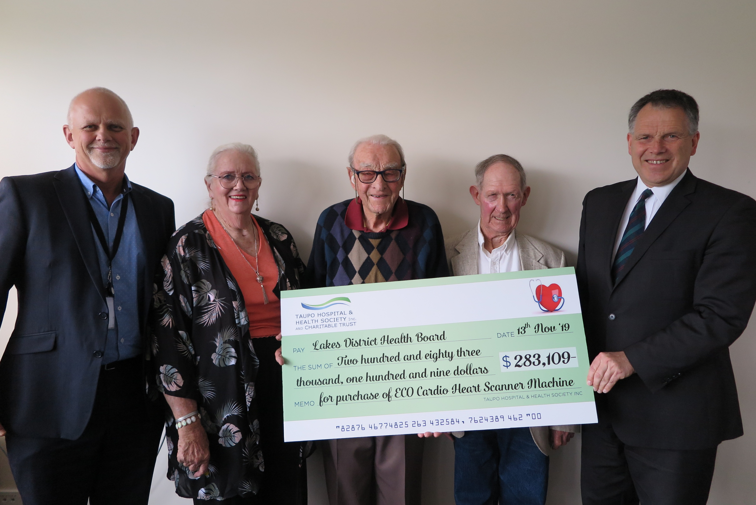
SUCCESSES

Slide 25

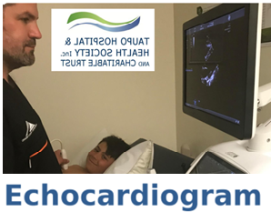

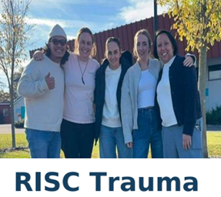

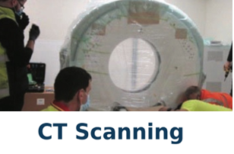
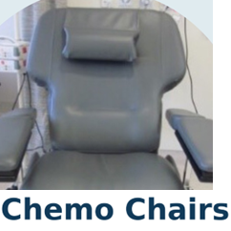
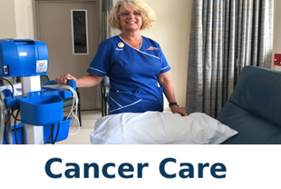
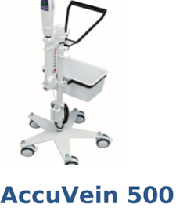
Our Projects
Ā mātou kaupapa
Our Projects /Ā mātou kaupapa
TESTIMONIALS

Slide 26
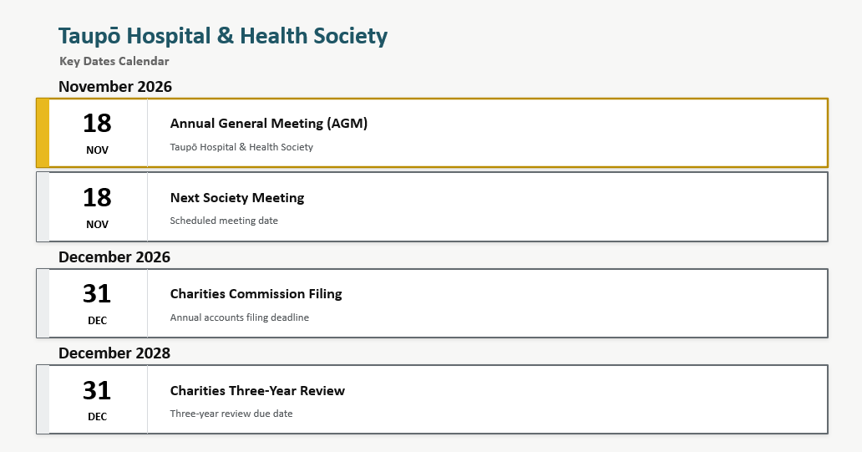
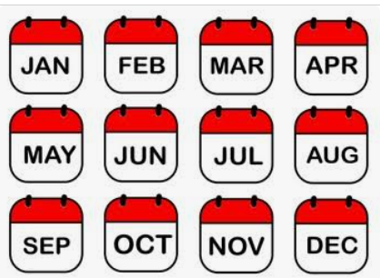
Our Projects
Ā mātou kaupapa
Events/Takahanga
KEY CALENDAR DATES

Slide 27





Our Projects
Ā mātou kaupapa
Get Involved/Whai wāhi mai
HOW CAN YOU SUPPORT US – CLICK ON THE RELEVANT ICON
Contact Us

Slide 28


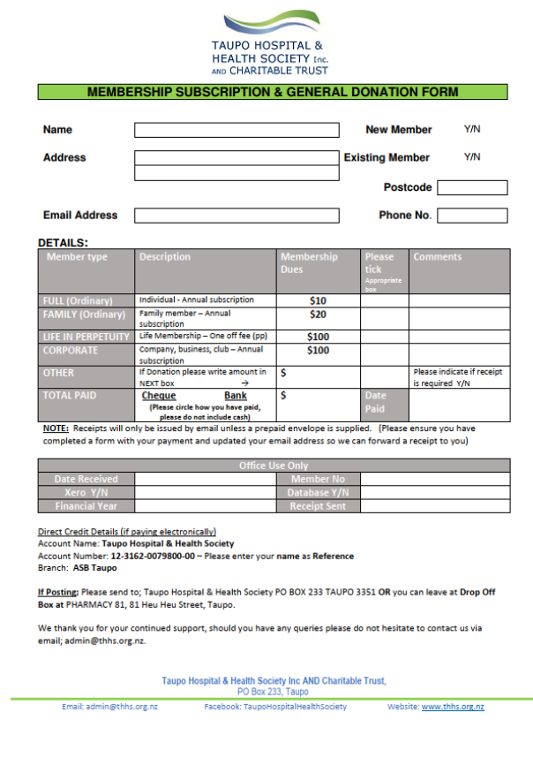
Link to our Givealittle page
https://my.givealittle.co.nz/
Link to Donation form
Link to our Contact Us page
Contact Us
Link to our Contact Us page
Link to our Contact Us pagec
Info for Ash Web Designer – need to give you a pdf for form membership donation

Slide 29
TAUPŌ HOSPITAL & HEALTH SOCIETY
Get in Touch
Contact the Society
We welcome enquiries from members of our community, organisations and supporters.
How to contact us
Email the Society or speak directly with our Chairperson or Secretary.
EMAIL
admin@thhs.org.nz
CHAIR
027 303 0642
SECRETARY
027 337 4804
Tell us why you are contacting the Society
Please state the reason in your email subject line or at the beginning of your message.
Donation
Funding request
General enquiry
Philanthrophy
Make a donation or discuss supporting the Society.
Ask about funding or submit a request for support.
Ask about the Society, its work or getting involved.
Discuss supporting the Society.
Please include
ONLINE CONTACT PAGE
• Your full name and preferred contact details • The reason for your email or call
• A brief summary of your enquiry or request • Any relevant organisation or supporting information
Contact us
Taupō Hospital & Health Society | Contact the Society

Slide 30
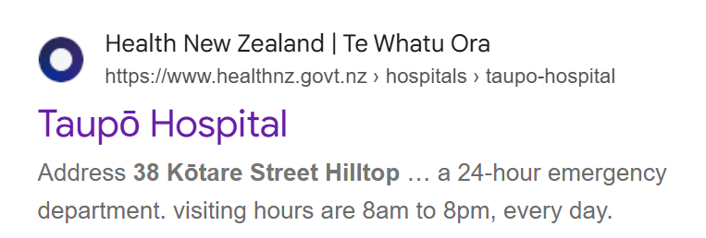
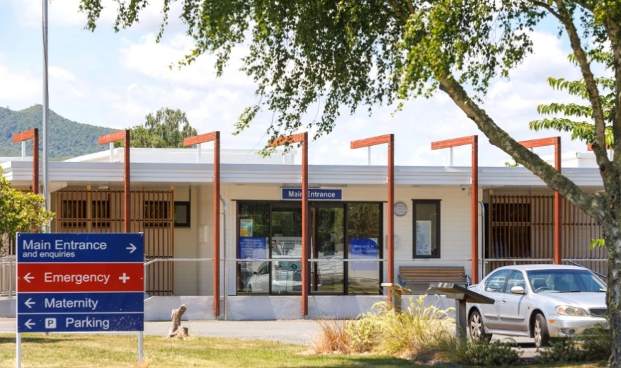
Our Hospital/Ā mātou Hōhipera

